Slide 1
Business Ethics & the use of data

Slide 2
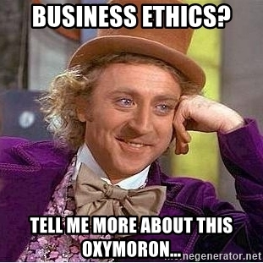
Does anyone have a definition of business ethics?
In 1970, Milton Friedman famously argued that the only social responsibility of business was to maximize profits.
“The only business of business is business” -President Calvin Coolidge

Slide 3
Does anyone have a definition of business ethics?
A set of behavioral standards informing and justifying your actions while transacting business, commerce etc.

Slide 4
What about in the context of data, machine learning & AI?

Slide 5
What about in the context of data, machine learning & AI?
Does using data and algorithms justify all actions since the underlying operations are just math?

Slide 6
What about in the context of data, machine learning & AI?
The use of data and mining approaches can be audited, so are the outcomes of those efforts justified?

Slide 7
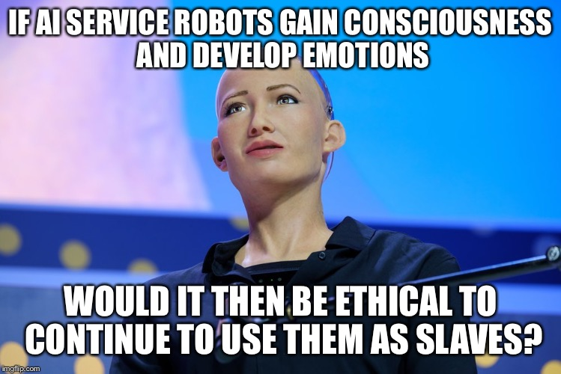
What about in the context of data, machine learning & AI?

Slide 8

Article 1
What was Knight Capital? What did they do?
What happened to them?

Slide 9
Article 1
Does HFT provide liquidity?
Does it negatively impact everyday investors? Do they provide real economic value?
Short term the market is a negative sum transaction due to these market makers. Is that fair for the retail investor or pension holder?

Slide 10
Article 1
Is there a business and data ethics question related to their demise?

Slide 11
Article 1
Is there a business and data ethics question related to their demise?
Who was impacted?
What did the practitioners and leaders miss?
What could have been done to mitigate the impact?

Slide 12

Article 2
What happened to Target?

Slide 13
Article 2
Is there a business and data ethics question? Who was impacted?
If so, what did the practitioners and leaders miss?
What could have been done to mitigate the impact?

Slide 14
Article 2
Is there a business and data ethics question? Who was impacted?
If so, what did the practitioners and leaders miss?
What could have been done to mitigate the impact?
Notice how Target originally wanted to brag about modeling & accuracy?
Why did they stop letting the data scientist talk to reporters?

Slide 15
Article 2
Is there a business and data ethics question? Who was impacted?
If so, what did the practitioners and leaders miss?
What could have been done to mitigate the impact?
Is predicting simply spying and a form of privacy invasion?
Is Target being underhanded by masking their intent with non pregnancy coupons?
Are consumers manipulated by these tactics or is it a benefit?

Slide 16

Article 3
What is Starbuck’s doing?

Slide 17
Article 3
Isn’t scheduling a normal operation of most businesses?

Slide 18
Article 3
Is there a business and data ethics question? Who was impacted?
If so, what did the practitioners and leaders miss?
What could have been done to mitigate the impact?

Slide 19
Article 3
Is there a business and data ethics question? Who was impacted?
If so, what did the practitioners and leaders miss?
What could have been done to mitigate the impact?
Does optimizing a schedule for near term hardship ultimately ensure success of the company and lead to job stability?
Does SBUX have a duty to employees as another stakeholder with varying social-economic situations?
Are customers willing to wait a few minutes longer due to less than fully optimized schedules?

Slide 20

Article 4
Is Watson amazing technology free from moral obligation?

Slide 21
Article 4
Is there a business and data ethics question? Who was impacted?
If so, what did the practitioners and leaders miss?
What could have been done to mitigate the impact?

Slide 22
Article 4
Is there a business and data ethics question? Who was impacted?
If so, what did the practitioners and leaders miss?
What could have been done to mitigate the impact?
Was it marketing ignorance, merely aspirational claims, or truly deceptive? Does that matter to patients?
What duty do the technical folks have to inform of limitations to sales, business and customers?
Do business leaders have a duty to question the choices and practices of technical creators?
What duty do the customers have to thoroughly review the underlying technology?

Slide 23

Article 5
Is there a business and data ethics question? Who was impacted?
If so, what did the practitioners and leaders miss?
What could have been done to mitigate the impact?

Slide 24
Article 5
Is there a business and data ethics question? Who was impacted?
If so, what did the practitioners and leaders miss?
What could have been done to mitigate the impact?
Harmless marketing stunt that turned ugly? If we have to filter the training data and provide guardrails do we invite censorship & bias?

Slide 25
Article 5
Is there a business and data ethics question? Who was impacted?
If so, what did the practitioners and leaders miss?
What could have been done to mitigate the impact?
What if Tay was supposed to make cancer recommendations, pick stocks for your retirement, recommend purchases, or schedule an appointment?

Slide 26
Article 5
Is there a business and data ethics question? Who was impacted?
If so, what did the practitioners and leaders miss?
What could have been done to mitigate the impact?
Letting it loose with public info allowed the technology to be corrupted almost immediately. However, once the scientist applies limitations to inputs, bias is introduced.

Slide 27
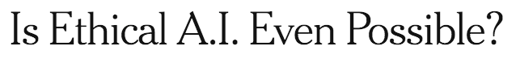


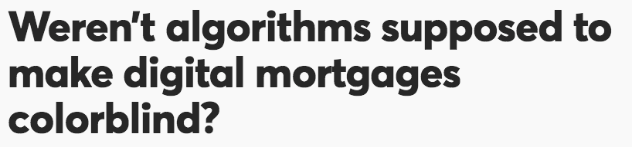
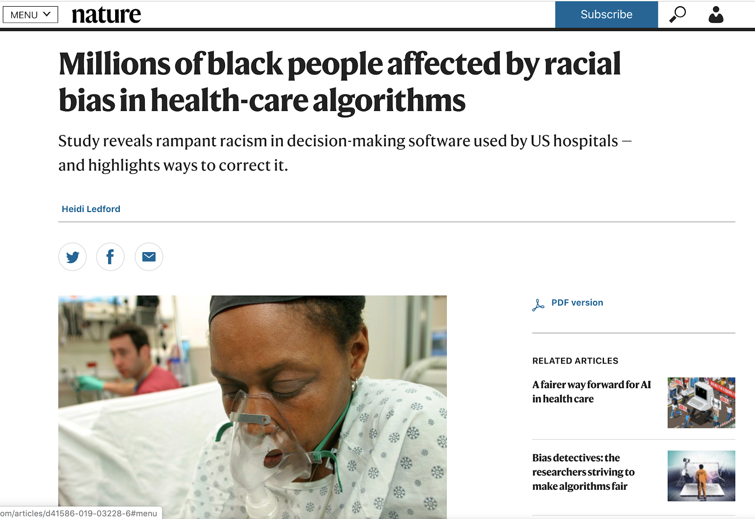
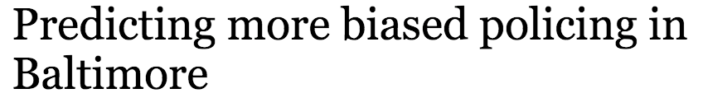
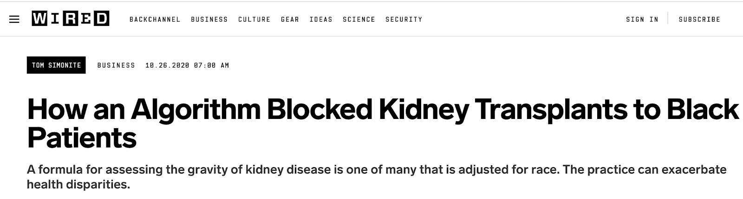
More Recent Topics in AI Ethics

Slide 28
Unfair AI isn’t doing something wrong – it’s exposing problems that already exist in human systems, the underlying data and/or models without proper governance.

Slide 29
Automated AI decision can have societal & economic impacts.
Public Sector Examples
Private Sector Examples
AI financial advisors liability & fiduciary duties lead to inaccurate risk/reward recommendations
Lending algorithms may reinforce long held discriminatory practices based on gender or race
Marketing algorithms can have amplifying effects
Racial disparity in access to public services
Reputational damage to government agencies
Reinforcing historical systemic issues, for example in criminal justice
As an emerging technology with great promise comes a greater responsibility to our citizens, economic viability & security.

Slide 30
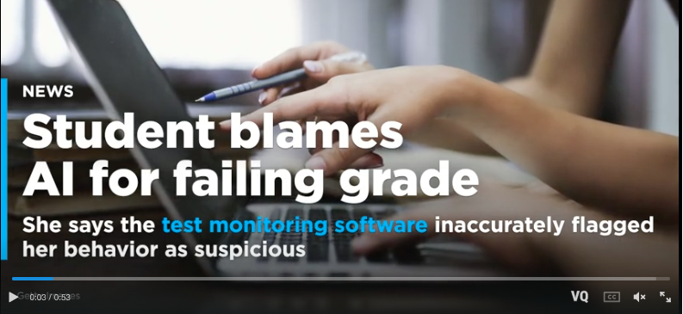
Machine Vision famously cannot detect people of color well. Used in remote proctoring this can be problematic.

Slide 31
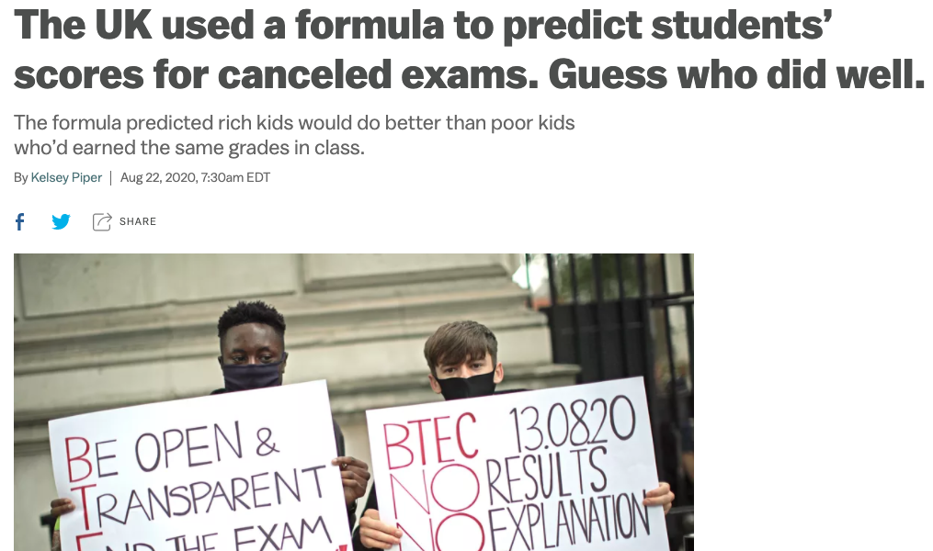
An algo reinforces patterns in the data, rich kids go to private school with smaller class sizes leading to better outcomes. Kids in other classes, with the same grades are predicted to do worse merely because of class size….and of course it falls along racial lines too.

Slide 32
Think about a framework for your own work
Decision Type I
Decision Type II
Decision Type III
Risk Size
Loss <$100K
$100L < loss < $1m or injury
Loss > $1m or death
Example
Probability of a banner ad click
Probability of mortgage default
Medical imaging scanning
Construction, Maintenance & Monitoring
+ Type I
+ Risk Assessment & Mitigation
+ Type I, II
+ Final augmented decision outcome
Human Role
In all automated decisions, humans are empowered and have a role to play.

Slide 33
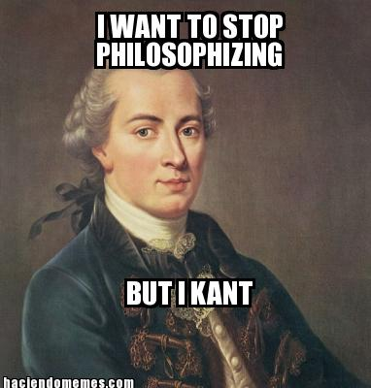
Some Popular Ethical Paradigms
Name | Proponent | Description | Example
Categorical Imperative | Kant | Make your action a universal law to see if it is ethical. Taken to an extreme, if the action becomes illogical, then it is immoral. | For stealing property…if everyone stole all property whenever they wanted then property itself loses all value making your act illogical. Therefore stealing is unethical.

Slide 34
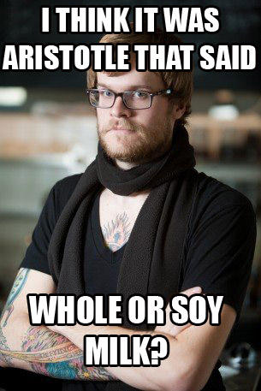
Some Popular Ethical Paradigms
Name | Proponent | Description | Example
Golden Mean | Plato/Socrates/Aristotle | Virtuous actions are between two extremes, deficiency and excess. At times, extremities are needed but mostly the middle (mean) is the moral choice. | Sometimes you should be courageous but not always…that would lead to a reckless death. Sometimes you need to be fearful but not always that would lead to unfulfilled opportunity as a coward.

Slide 35
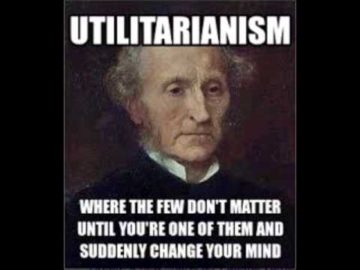
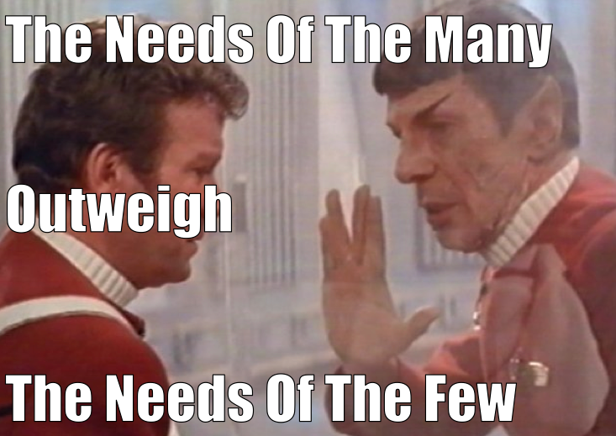
Some Popular Ethical Paradigms
Name | Proponent | Description | Example
Utilitarianism Self –interest Common Good | Mill | Ethical decisions are those that maximize happiness and minimize pain. “it’s ok to hurt a small group to maximize the gain for the larger group.” | Vaccines can cause significant problems so the government set up a fund to help victims of vaccine side affects. Vaccines benefit society by eradicating disease.

Slide 36
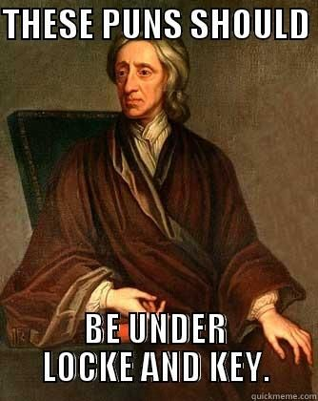
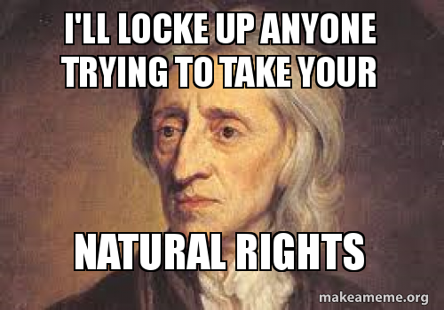
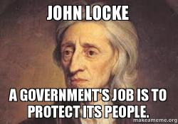
Some Popular Ethical Paradigms
Name | Proponent | Description | Example
Rights based | Locke | Humans beings are an “end” not a “means” and should be treated that way. | All human being have the right to dignity and other debated rights. Does this extend to animals? Conscience robots?

Slide 37
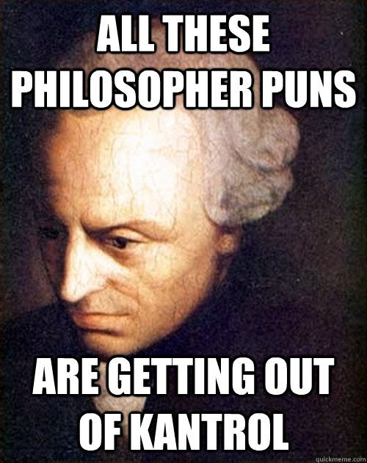
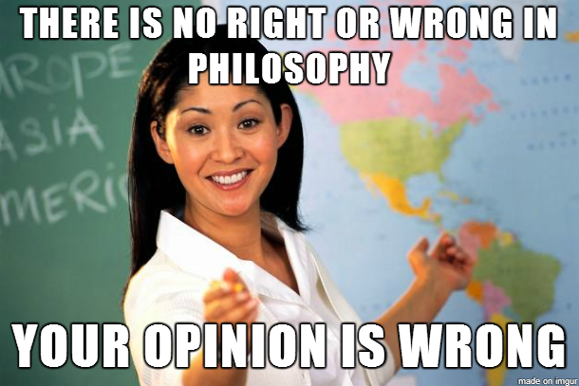
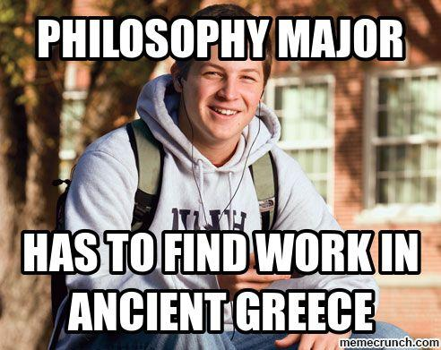
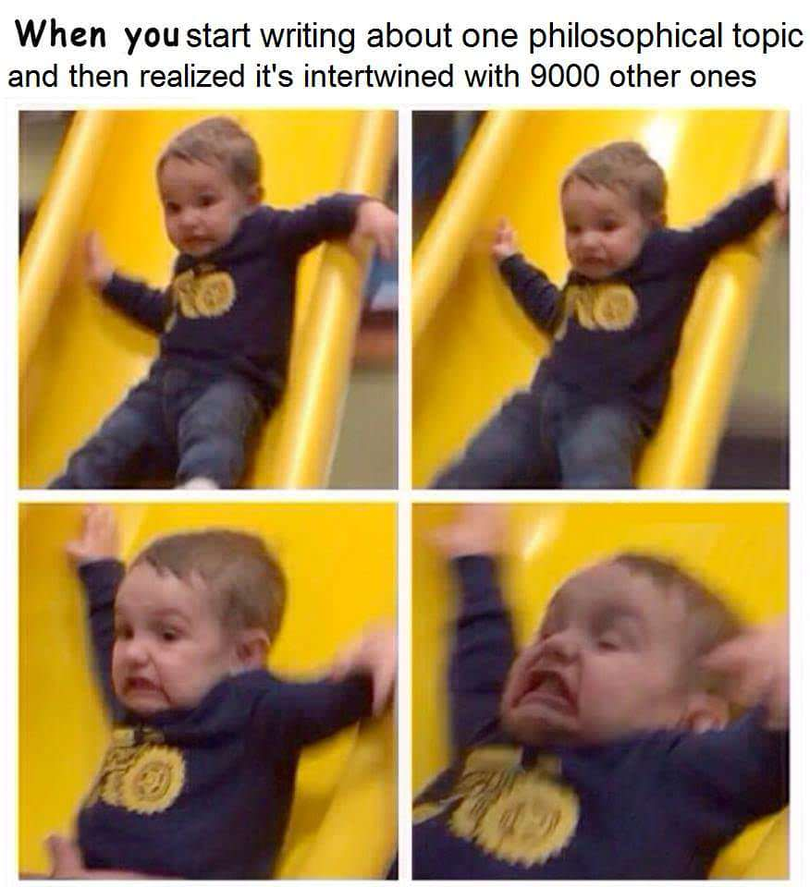

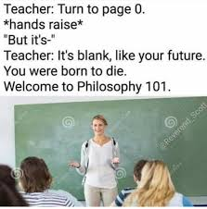
Some Popular Ethical Paradigms
Take some time to reflect on how you would react and which of these (and others perspectives) resonate with you.

Slide 38
Popular Ethical Paradigms
As you become a business leader or technician, having predefined values will help you in the moment.

Slide 39
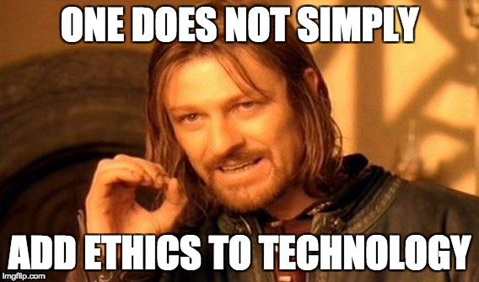
Technology is a means to an end. Stating data mining represents progress is misleading. What is the end achieved?

Slide 40
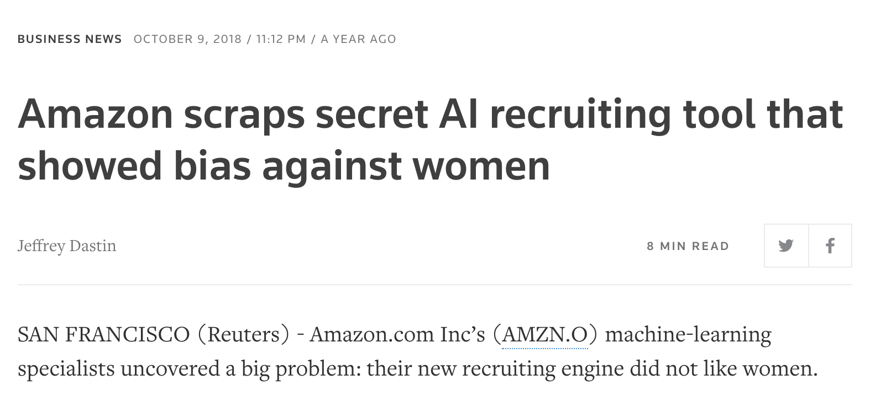
Ethical ML/AI
Aligns to your organization’s value

Slide 41
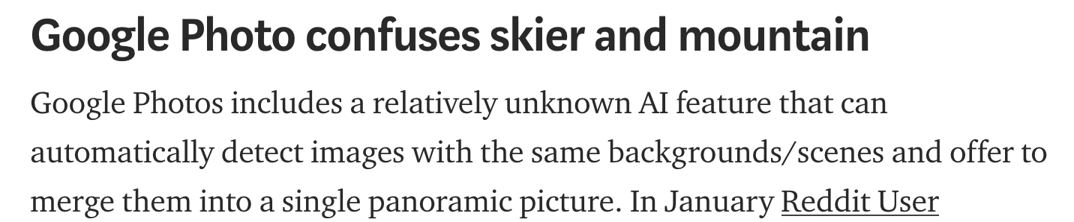
Ethical ML/AI
Is Explainable & Intuitive (not necessarily transparent)
?

Slide 42
Ethical ML/AI
Behaves as expected

Slide 43
Ethical ML/AI
Aligns to your organization’s value
Is Explainable
Behaves as expected
Having all 3 in a production model will help organizations realize value and mitigates risk.

